Slide 1

Effective Pre-training and Fine-tuning for
Few-shot Image Recognition
Arman Afrasiyabi
Ph.D. student at Université Laval

Slide 2
Effective Pre-training and Fine-tuning for
Few-shot Image Recognition
Arman Afrasiyabi
Ph.D. student at Université Laval

Slide 3

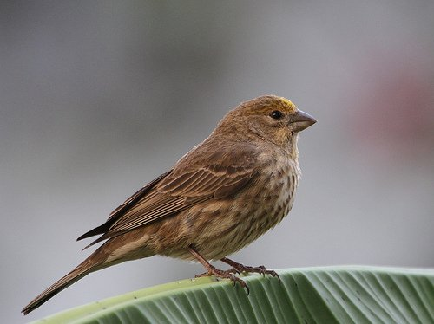
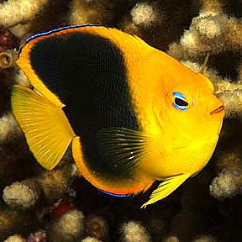
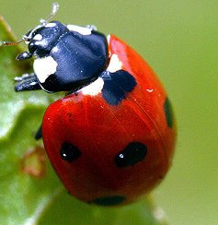
Image Recognition
1
Photo credit: biocomplexity.virginia.edu/our-research
Notes:
Photo credit:
https://news.gsu.edu/files/2021/01/Deep-learning-neural-network.jpg

Slide 4
Training data
1
Notes:
Photo credit:
https://www.sandrakennedy.org/wp-content/uploads/2019/10/question-mark-stack-1024x538.jpg

Slide 5
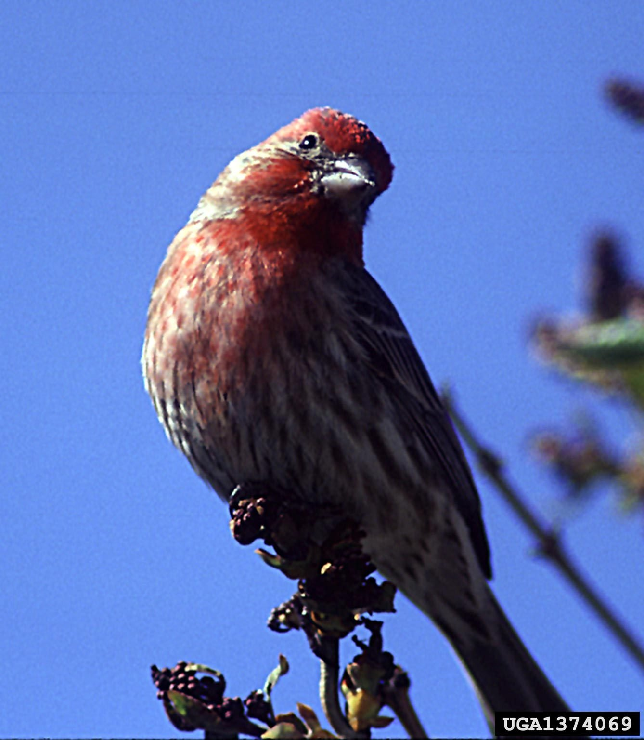
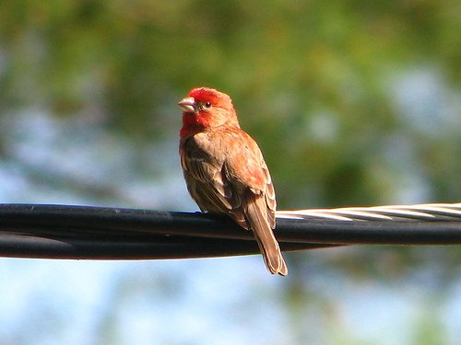
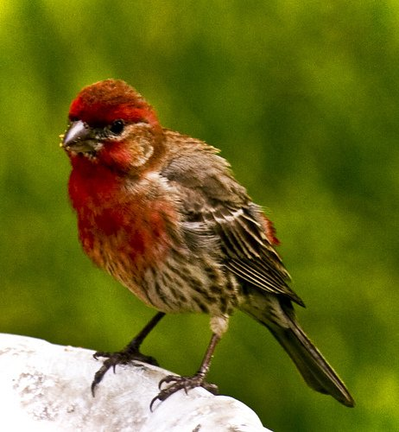
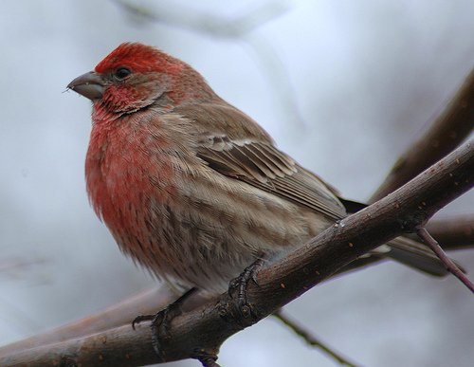
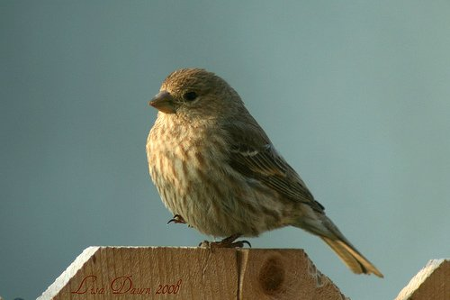
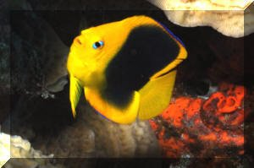
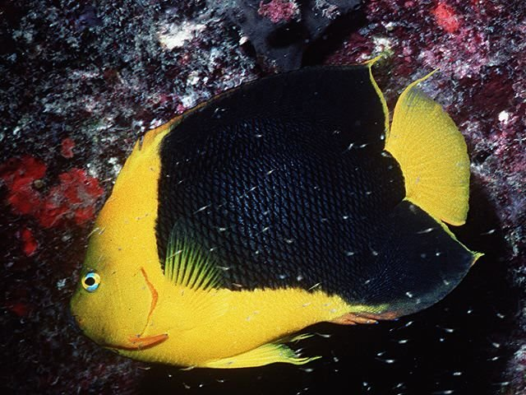
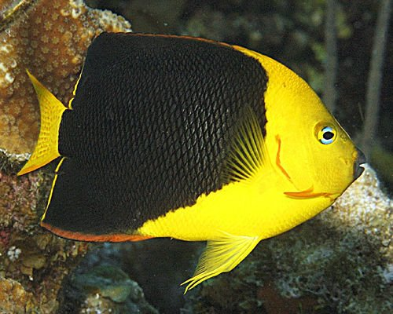
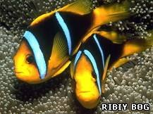
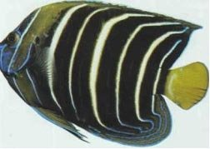
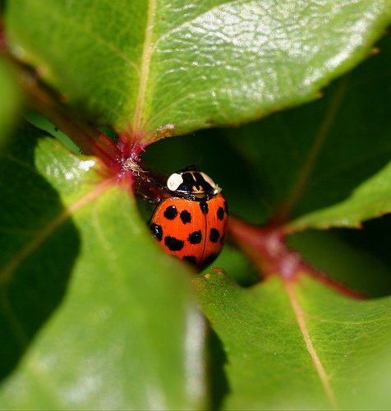
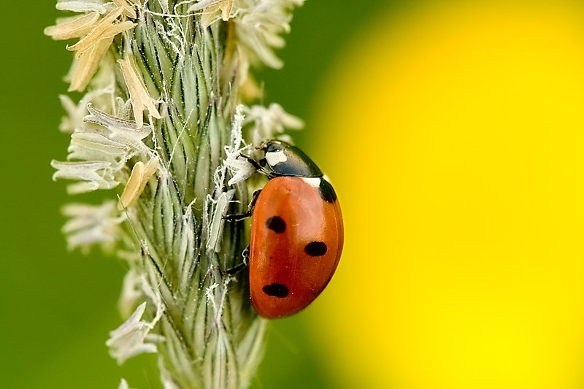
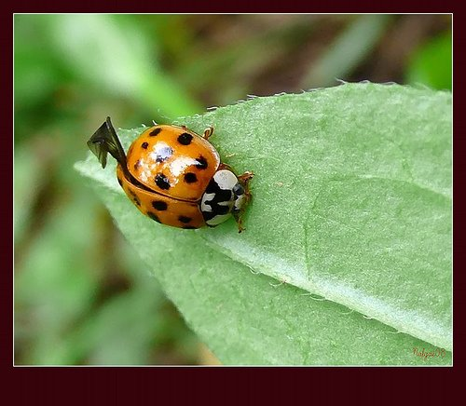
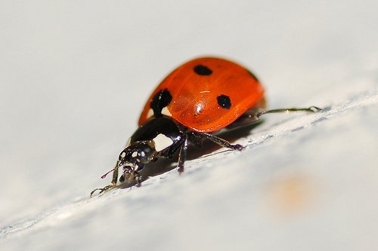
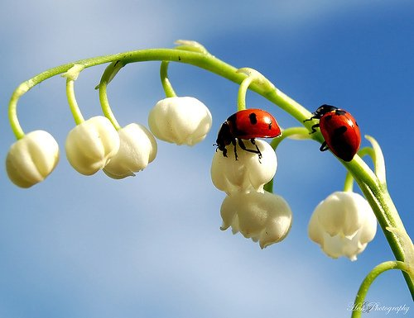
Training data
2
Notes:
Photo credit:
https://www.sandrakennedy.org/wp-content/uploads/2019/10/question-mark-stack-1024x538.jpg

Slide 6
Training data
3
Notes:
Photo credit:
https://www.sandrakennedy.org/wp-content/uploads/2019/10/question-mark-stack-1024x538.jpg

Slide 7
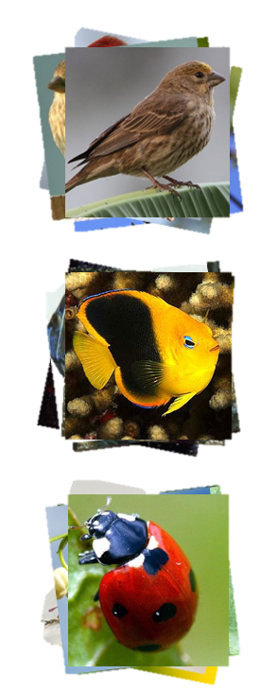
Training data
3
Notes:
Photo credit:
https://www.sandrakennedy.org/wp-content/uploads/2019/10/question-mark-stack-1024x538.jpg

Slide 8
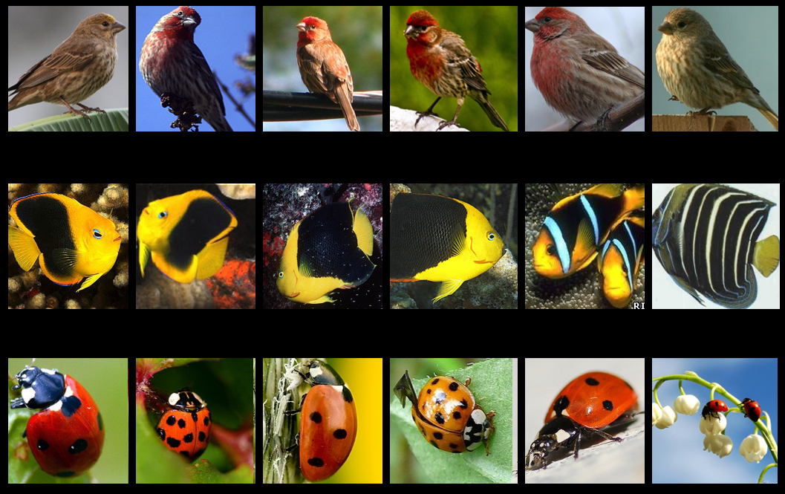
Training neural network
Neural Network
sampled batch
Training data
3
Notes:
Photo credit:
https://www.sandrakennedy.org/wp-content/uploads/2019/10/question-mark-stack-1024x538.jpg

Slide 9
Training neural network
prediction
true label
Neural Network
sampled batch
Training data
3
Notes:
Photo credit:
https://www.sandrakennedy.org/wp-content/uploads/2019/10/question-mark-stack-1024x538.jpg

Slide 10
Training neural network
Neural Network
sampled batch
Training data
3
Notes:
Photo credit:
https://www.sandrakennedy.org/wp-content/uploads/2019/10/question-mark-stack-1024x538.jpg

Slide 11
Training neural network
prediction
true label
Neural Network
sampled batch
Training data
3
Notes:
Photo credit:
https://www.sandrakennedy.org/wp-content/uploads/2019/10/question-mark-stack-1024x538.jpg

Slide 12
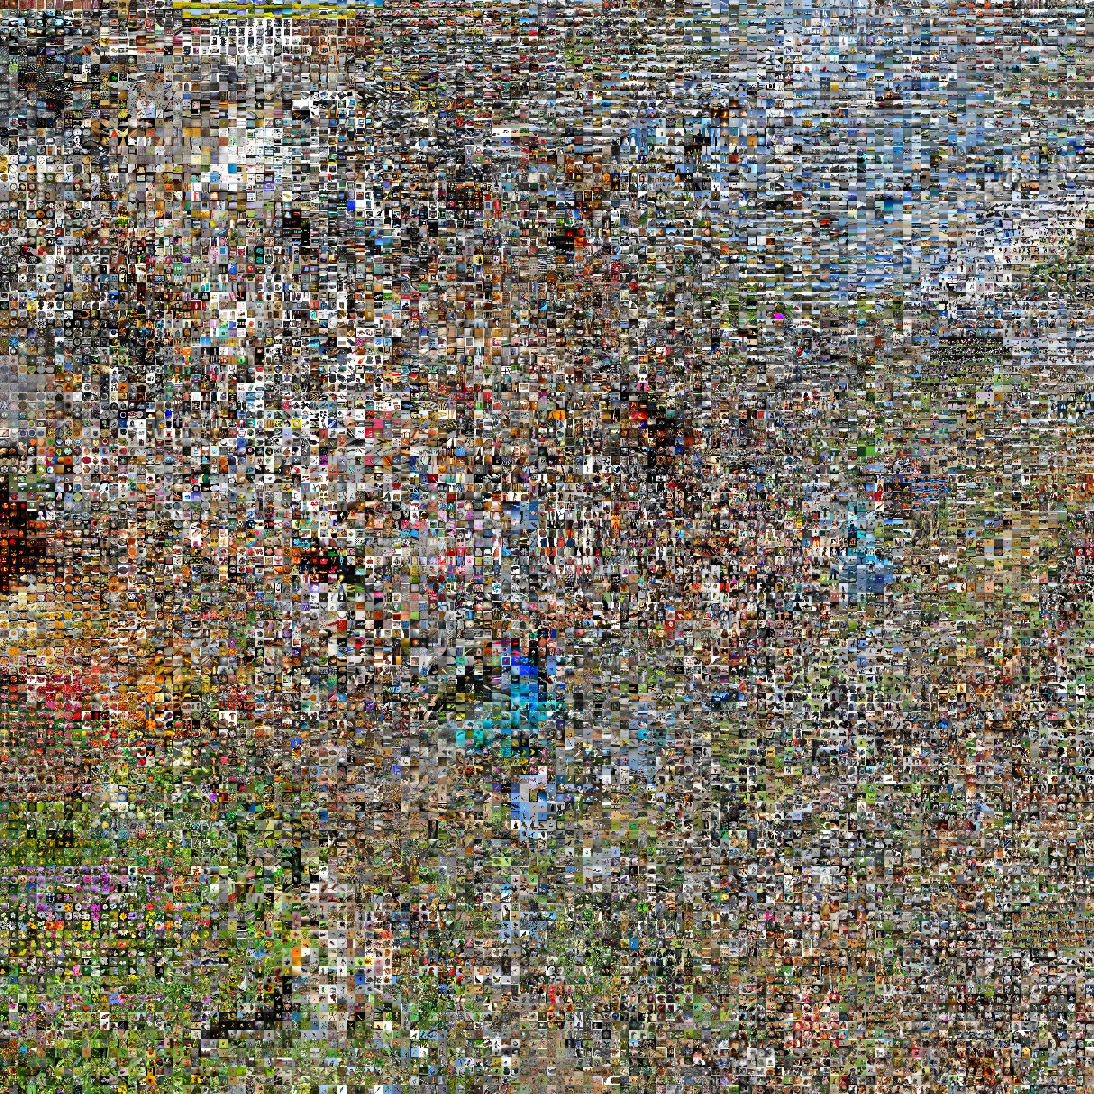
ImageNet Challenge
- 1.2 million training image
- 1000 base classes
4
Notes:
Photo credit:
https://www.sandrakennedy.org/wp-content/uploads/2019/10/question-mark-stack-1024x538.jpg

Slide 13
ImageNet Challenge
human accuracy: 95%
Classification Accuracy
5
Deep neural networks
Notes:
Photo credit:
https://www.sandrakennedy.org/wp-content/uploads/2019/10/question-mark-stack-1024x538.jpg

Slide 14

Are we done with image recognition?
Photo credit: vwww.sandrakennedy.org
Notes:
Photo credit:
https://www.sandrakennedy.org/wp-content/uploads/2019/10/question-mark-stack-1024x538.jpg

Slide 15
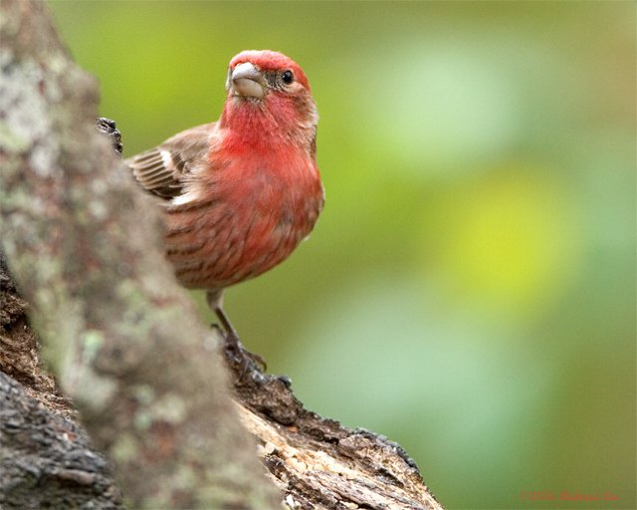
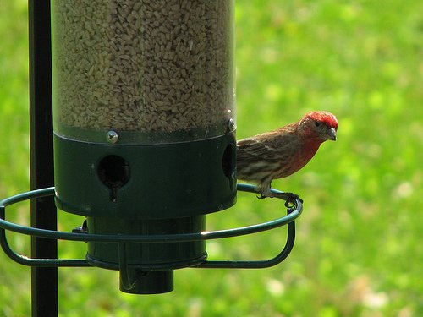
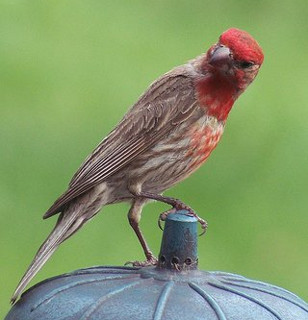
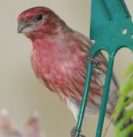
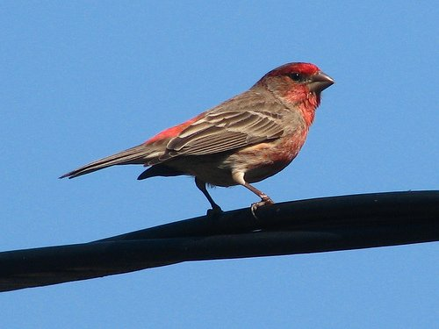
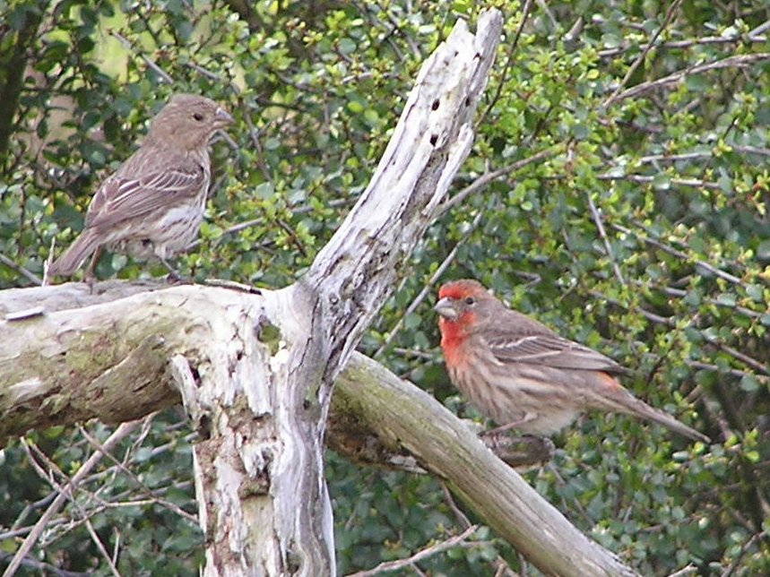
Are we done with image recognition?
Training
(base class)
Neural Network
Testing
(base class)
6
Notes:
Photo credit:
https://www.sandrakennedy.org/wp-content/uploads/2019/10/question-mark-stack-1024x538.jpg

Slide 16
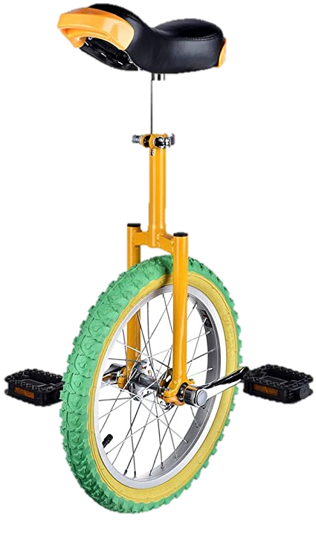
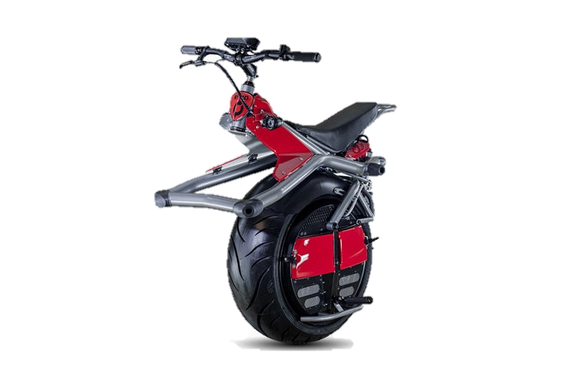
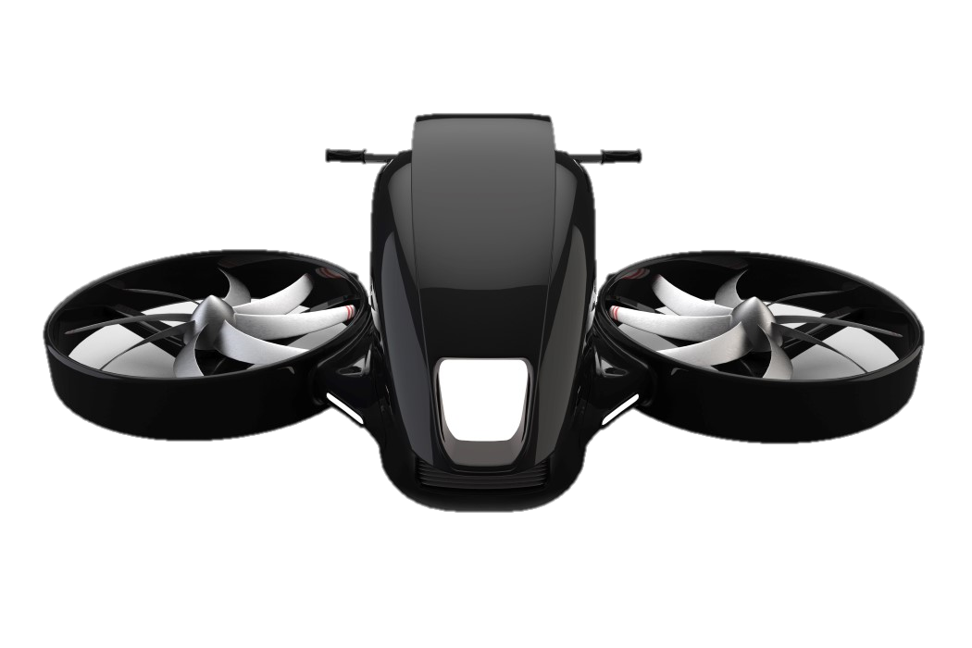
Real world case
Training
(base class)
Neural Network
Testing
(novel class)
7
Notes:
Photo credit:
https://www.sandrakennedy.org/wp-content/uploads/2019/10/question-mark-stack-1024x538.jpg

Slide 17
Pre-training
and Fine-tuning
8
Notes:
Photo credit:
https://www.sandrakennedy.org/wp-content/uploads/2019/10/question-mark-stack-1024x538.jpg

Slide 18

Pre-training
Training
data
Testing
data
Photo credit: line.17qq.com/articles/chcpnopv.html
8
Notes:
Photo credit:
https://www.sandrakennedy.org/wp-content/uploads/2019/10/question-mark-stack-1024x538.jpg

Slide 19

Fine-tune
Photo credit: publicdomainvectors.org/en/free-vector-face-profile-silhouette
9
Notes:
Photo credit:
https://www.sandrakennedy.org/wp-content/uploads/2019/10/question-mark-stack-1024x538.jpg

Slide 20
Learning to learn form 1-shot
Photo credit: publicdomainvectors.org/en/free-vector-face-profile-silhouette , esquire.com, ebay.com
9
Notes:
Photo credit:
https://www.sandrakennedy.org/wp-content/uploads/2019/10/question-mark-stack-1024x538.jpg
Motor photo:
https://www.wired.com/2014/01/ryno-electric-unicycle/
https://www.yankodesign.com/2019/01/16/future-of-technology-summit-to-host-public-showcase-of-personal-jet-packs/
https://www.yankodesign.com/2018/11/15/flying-bikes-are-coming-soon-to-rid-you-of-your-traffic-woes/

Slide 21
Few-shot learning

Slide 22
Few-shot learning
Pre-training
Fine-tuning
Base classes
Novel classes
Photo credit: esquire.com, ebay.com
11

Slide 23
Few-shot learning
Pre-training
Fine-tuning
Base classes
Novel classes
Neural Network
12

Slide 24
Effective Pre-training and Fine-tuning for
Few-shot Image Recognition
Arman Afrasiyabi
Ph.D. student at Université Laval
13

Slide 25
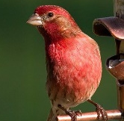
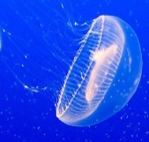
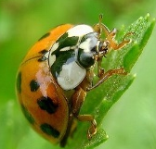
Typical pre-training
feature space
base class vectors
…
image imbeds
Neural
Network
…
…
batch
of base classes
14

Slide 26
Typical pre-training
feature space
base class vectors
…
image imbeds
Neural
Network
…
…
batch
of base classes
14

Slide 27
Typical pre-training
feature space
base class vectors
…
image imbeds
Neural
Network
…
…
batch
of base classes
Photo credit
14

Slide 28
Typical pre-training
feature space
Base class vectors
…
image imbeds
Neural
Network
…
…
uncertain
region
Train data
Test data
Mixture-based Feature Space Learning for Few-Shot Image Classification. Afrasiyabi A., Lalonde JF., Gagné C. (2021), under Review.
14

Slide 29
Mixture-based Feature Space Learning
Afrasiyabi A., Lalonde JF., Gagné C. (2021)
Mixture-based Feature Space Learning for Few-Shot Image Classification. Afrasiyabi A., Lalonde JF., Gagné C. (2021), under Review.
15

Slide 30
Mixture-based Feature Space Learning
MixtFSL
15

Slide 31
MixtFSL
15

Slide 32

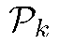
MixtFSL
…
Neural
Network
…
…
batch
16

Slide 33
MixtFSL
…
Neural
Network
…
…
feature space
17

Slide 34
MixtFSL
…
Neural
Network
…
…
Two criteria
in feature space
17

Slide 35
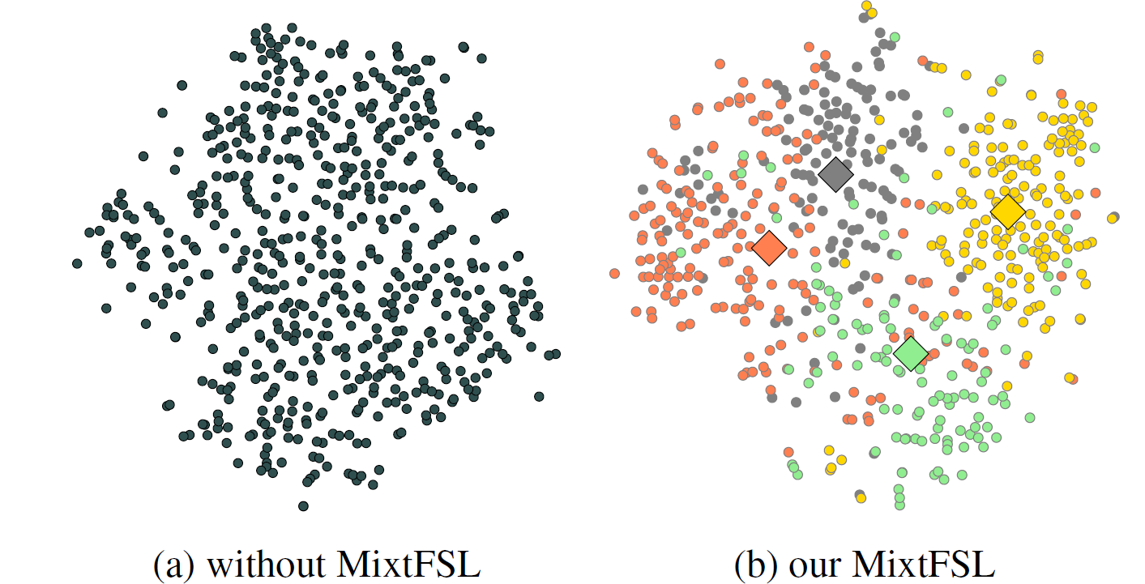
MixtFSL: visualization
18

Slide 36
1-example evaluation
miniImageNet
tieredImageNet
FC100
19

Slide 37
5-example evaluation
miniImageNet
tieredImageNet
FC100
20

Slide 38

Few-shot learning
Pre-training
Fine-tuning
Base classes
Novel classes
Mixture-based Feature Space Learning for Few-Shot Image Classification.
Afrasiyabi A., Lalonde JF., Gagné C. (2021), under Review.
Associative Alignment for Few-Shot Image Classification
Afrasiyabi A., Lalonde JF., Gagné C. (2020), ECCV, 2020 (Spotlight; top 5%).

Slide 39
Effective Pre-training and Fine-tuning for
Few-shot Image Recognition
Arman Afrasiyabi
Ph.D. student at Université Laval

Slide 40
Fine-tuning
Notes:
In this study,
We leverage Chen work which has demonstrated that transfer learning can be effective for few-shot classification.
Given the base categories in the pretraining stage (shown by circles), THE feature extractor is trained using a metric learning criteria.

Slide 41

Typical Fine-tuning
base class vectors
…
image imbeds
Neural
Network
…
…
batch
of base classes
21

Slide 42
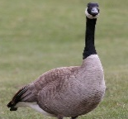

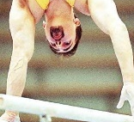
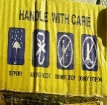
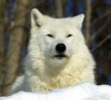
Typical Fine-tuning
image imbeds
Neural
Network
novel classes
5-way/1-shot
21

Slide 43
Typical Fine-tuning
image imbeds
Neural
Network
novel classes
5-way/1-shot
21

Slide 44
Associative Alignment for Few-shot Image Classification
Afrasiyabi A., Lalonde JF., Gagné C. (2020), ECCV, 2020 (Spotlight; top 5%).
Associative Alignment for Few-shot Image Classification
Afrasiyabi A., Lalonde JF., Gagné C. (2020), ECCV, 2020 (Spotlight; top 5%).
22

Slide 45
Associative Alignment
Associative Alignment for Few-shot Image Classification
Afrasiyabi A., Lalonde JF., Gagné C. (2020), ECCV, 2020 (Spotlight; top 5%).
22

Slide 46
Associative Alignment
23

Slide 47
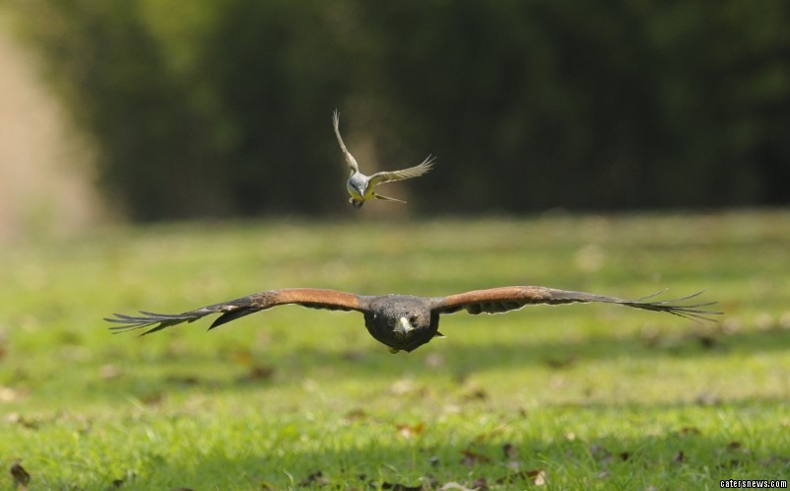
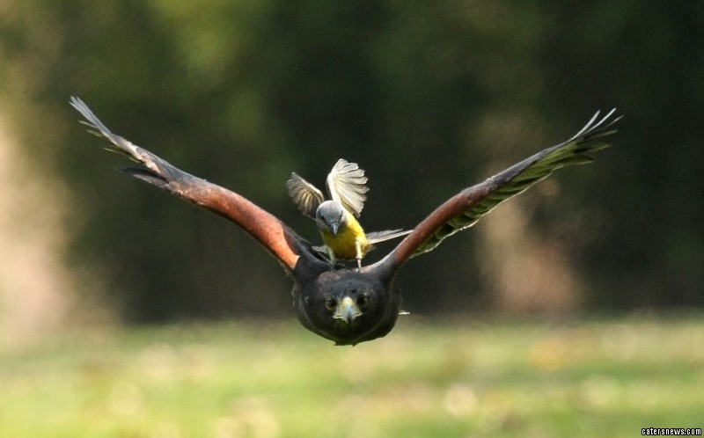
Associative Alignment
Photo credit
23
www.catersnews.com

Slide 48
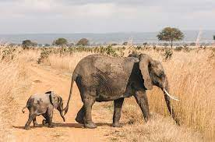
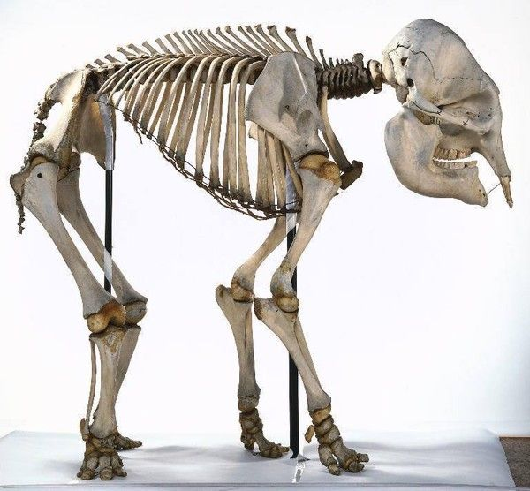
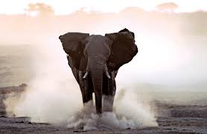
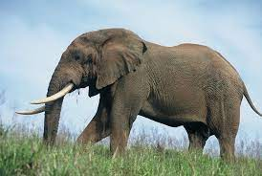
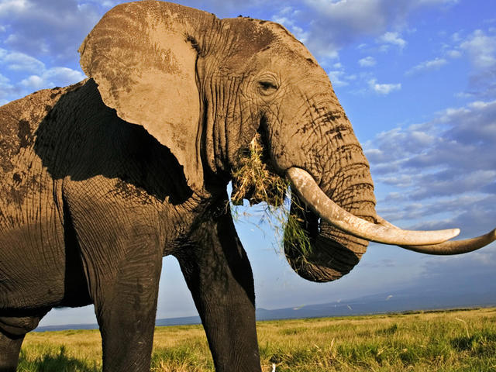
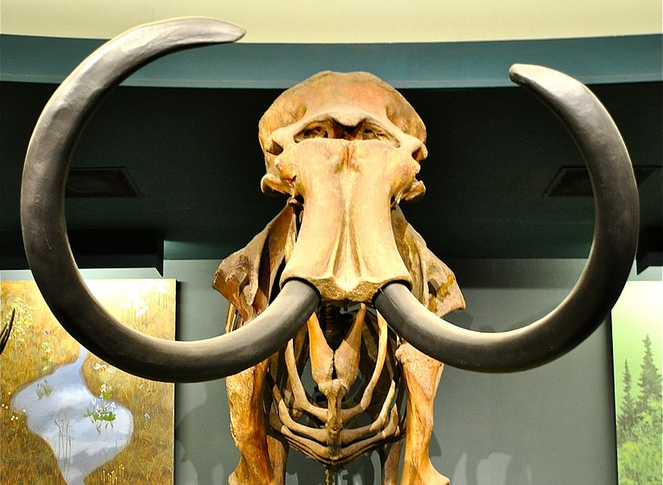
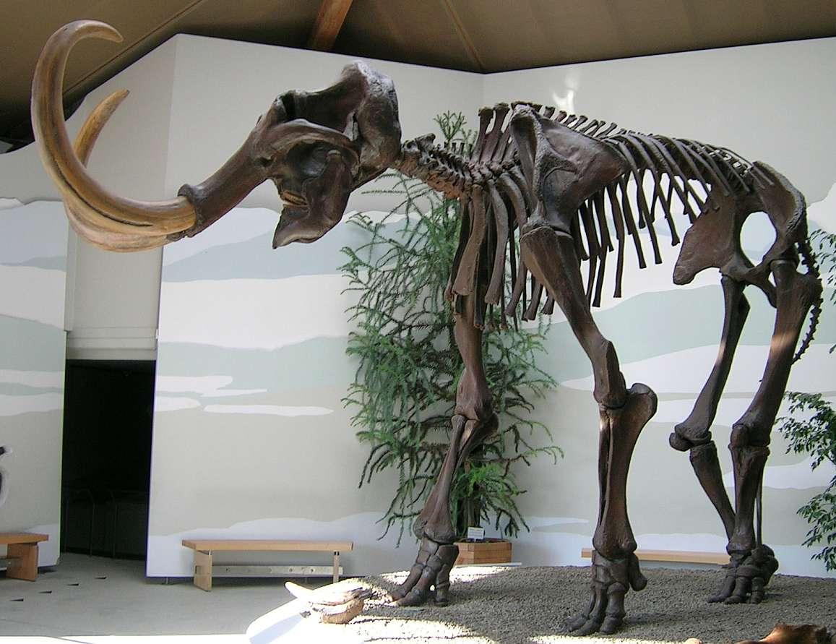
Associative Alignment
Base class (elephant)
…
Fine-tuning (mammoth)
www.shutterstock.com
https://wikivisually.com/
24
Notes:
https://www.google.com/search?q=elephant+skeleton&newwindow=1&rlz=1C1CHBF_enCA924CA924&sxsrf=ALeKk033zvnO9ToWYj_W5Q2MLJ-dfnaI3w:1616088960965&tbm=isch&source=iu&ictx=1&fir=5XuQ1Tikh0rLQM%252ChgrxKmIcnxKLLM%252C_&vet=1&usg=AI4_-kTvleWDKAyKYoB88qmbXi55LTnH2g&sa=X&ved=2ahUKEwij4sXDsLrvAhUxMVkFHbgYCXsQ9QF6BAgJEAE&biw=1536&bih=704&dpr=1.25#imgrc=G11MOIaciINYeM

Slide 49
Associative Alignment
…
www.shutterstock.com
https://wikivisually.com/
24
Notes:
https://www.google.com/search?q=elephant+skeleton&newwindow=1&rlz=1C1CHBF_enCA924CA924&sxsrf=ALeKk033zvnO9ToWYj_W5Q2MLJ-dfnaI3w:1616088960965&tbm=isch&source=iu&ictx=1&fir=5XuQ1Tikh0rLQM%252ChgrxKmIcnxKLLM%252C_&vet=1&usg=AI4_-kTvleWDKAyKYoB88qmbXi55LTnH2g&sa=X&ved=2ahUKEwij4sXDsLrvAhUxMVkFHbgYCXsQ9QF6BAgJEAE&biw=1536&bih=704&dpr=1.25#imgrc=G11MOIaciINYeM

Slide 50
Associative Alignment
25
Notes:
https://www.google.com/search?q=elephant+skeleton&newwindow=1&rlz=1C1CHBF_enCA924CA924&sxsrf=ALeKk033zvnO9ToWYj_W5Q2MLJ-dfnaI3w:1616088960965&tbm=isch&source=iu&ictx=1&fir=5XuQ1Tikh0rLQM%252ChgrxKmIcnxKLLM%252C_&vet=1&usg=AI4_-kTvleWDKAyKYoB88qmbXi55LTnH2g&sa=X&ved=2ahUKEwij4sXDsLrvAhUxMVkFHbgYCXsQ9QF6BAgJEAE&biw=1536&bih=704&dpr=1.25#imgrc=G11MOIaciINYeM

Slide 51
Detecting related bases
Neural
Network
Associative Alignment for Few-shot Learning., Afrasiyabi A., Lalonde JF., Gagné C. (2020), ECCV, 2020 (Spotlight; top 5%).
25
Notes:
Finally, we select B number of highly related base classes for each of the novel classes.
For example, here B is equal to 1.

Slide 52
Centroid alignment
shared weights
classification criteria
classification criteria
alignment criteria
25
Notes:
Here, you see an illustration of the centroid alignment, which the novel categories (in diamond) are aligned to the center of their related bases (in circles).

Slide 53
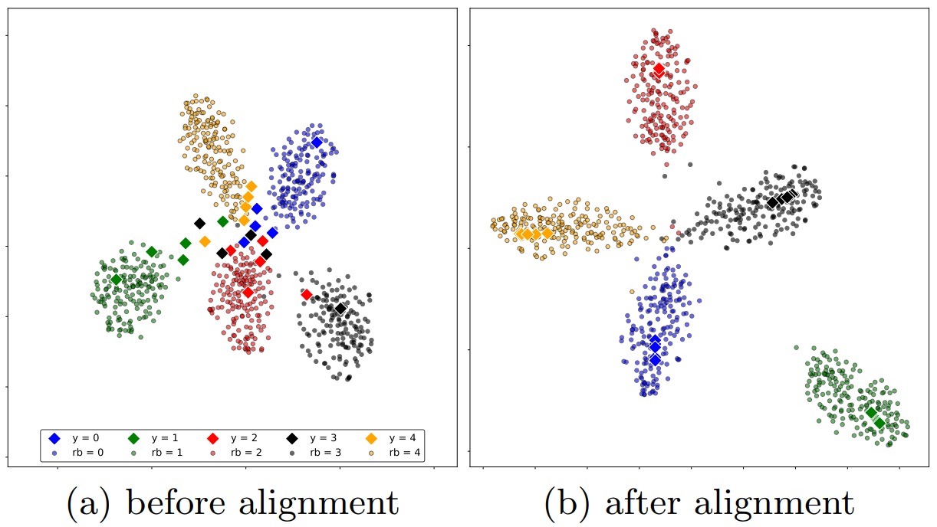
Associative Alignment
26

Slide 54
1-example evaluation
miniImageNet
tieredImageNet
CUB
27
Notes:
Our approach, in orange, significantly improves over the state of the art shown in blue in 5-shot using the Resnet backbone.
We Show results on
Object recognition on mini-ImageNet, tieredImageNet;
Cross-domain adaptation from mini-ImageNet to CUB.

Slide 55
5-example evaluation
miniImageNet
tieredImageNet
CUB
28
Notes:
Our approach, in orange, significantly improves over the state of the art shown in blue in 5-shot using the Resnet backbone.
We Show results on
Object recognition on mini-ImageNet, tieredImageNet;
Cross-domain adaptation from mini-ImageNet to CUB.

Slide 56
Few-shot learning
Pre-training
Fine-tuning
Base classes
Novel classes
Mixture-based Feature Space Learning for Few-Shot Image Classification.
Afrasiyabi A., Lalonde JF., Gagné C. (2021), under Review.
Associative Alignment for Few-Shot Image Classification
Afrasiyabi A., Lalonde JF., Gagné C. (2020), ECCV, 2020 (Spotlight; top 5%).
29

Slide 57


My special thanks to my supervisors
Notes:
In this study,
We leverage Chen work which has demonstrated that transfer learning can be effective for few-shot classification.
Given the base categories in the pretraining stage (shown by circles), THE feature extractor is trained using a metric learning criteria.

Slide 58
My special thanks to my supervisors
Thank you!
All the non cited animal images in this presentation are credited to ImageNet (a public available dataset challenge).
Notes:
In this study,
We leverage Chen work which has demonstrated that transfer learning can be effective for few-shot classification.
Given the base categories in the pretraining stage (shown by circles), THE feature extractor is trained using a metric learning criteria.

Slide 59
Notes:
In this study,
We leverage Chen work which has demonstrated that transfer learning can be effective for few-shot classification.
Given the base categories in the pretraining stage (shown by circles), THE feature extractor is trained using a metric learning criteria.

Slide 60
Additional slides
Notes:
In this study,
We leverage Chen work which has demonstrated that transfer learning can be effective for few-shot classification.
Given the base categories in the pretraining stage (shown by circles), THE feature extractor is trained using a metric learning criteria.

Slide 61
Self-supervised MixtFSL
Current Project

Slide 62
Self-MixtFSL
Self-supervised MixtFSL
Current Project

Slide 63
Self-MixtFSL
…
…
…

Slide 64

Typical pre-training
feature space
…
Neural
Network
…
…
batch
Train data
Test data

Slide 65
Self-MixtFSL

Slide 66
Thank you!
Notes:
In this study,
We leverage Chen work which has demonstrated that transfer learning can be effective for few-shot classification.
Given the base categories in the pretraining stage (shown by circles), THE feature extractor is trained using a metric learning criteria.

Slide 67

Notes:
In this study,
We leverage Chen work which has demonstrated that transfer learning can be effective for few-shot classification.
Given the base categories in the pretraining stage (shown by circles), THE feature extractor is trained using a metric learning criteria.

Slide 68
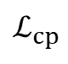

Initial training
…
$${\text{ℒ}}_{cl}$$
$${\text{ℒ}}_{cp}$$
…
…
loss computation
in feature space

Slide 69




Progressive following
updating the best model
updating the component set
…
…
…
…
…
$${\text{ℒ}}_{pr}$$
$${\text{ℒ}}_{pr}$$
…
…
…
training time (epoch)

Slide 70
Experiments
Datasets
Backbones
Object recognition
• miniImageNet
• tieredImageNet
• FC100
Fine-grained classification
• CUB
Cross-domain adaptation
• from miniImageNet to CUB
Conv4
ResNet-18
WRN-28-10
Notes:
We test the associative alignment using four dataset in three following frameworks
Object recognition on mini-ImageNet, tieredImageNet, and FC100;
Fine-grained classification on CUB;
Cross-domain adaptation from mini-ImageNet to CUB.
In the experiments, we used three backbones!

Slide 71
Fine-tuning
feature extractor
Notes:
One possible solution IS to fix the feature extractor, BUT, this makes classification harder.

Slide 72









Adversarial alignment
shared weights
$$ℒ_{aa}$$
$$ℒ_{aa}$$
$$ℒ_{clf}$$
$$ℒ_{clf}$$
C($∙$|W)
$$ℒ_{clf}$$
$$ℒ_{clf}$$
$$ℒ_{aa}$$
$$ℒ_{h}$$
Associative Alignment for Few-shot Learning., Afrasiyabi A., Lalonde JF., Gagné C. (2020), ECCV, 2020 (Spotlight; top 5%).
Notes:
Please note that centroid alignment has the metric-learning property which does not included in adversarial alignment.

Slide 73


miniImageNet
ResNet-12

Slide 74

tieredImageNet
ResNet-12

Slide 75
FC100
ResNet-12

Slide 76

CUB and cross domain

Slide 77


Slide 78


Closer look at prototypical network
KR Allen et al. 2019

Slide 79
Model fitting spectrum
KR Allen et al. 2019

Slide 80
Closer look at IMP
This is accomplished by
- DP-means inside the episodic training loop.
KR Allen et al. 2019

Slide 81

Infinite mixture prototypes (IMP)
Naïve solution
k-mean on all the embedding examples
i-th class embedding
KR Allen et al. 2019

Slide 83
Feature visualization (t-SNE on RN-18)

Slide 84











PMM-Alignment Extension
${\text{C}}_{bs}$($∙$|P)
…
$$ℒ_{bs}$$
$$f(⋅|θ)$$
5-way, 1-shot novel categories
a batch from base categories
$$ℒ_{ca}$$
$$ℒ_{nv}$$
${\text{C}}_{nv}$($∙$|W)

Slide 85
Current project
Self-PMM
under self-supervised learning framework

Slide 86

Thank you for your time!

Slide 87

Remaining components

Slide 88




Examples of related bases
novel
related bases
Notes:
Let’s see some examples of the detected classes for B=10 in 5-shot scenario,
where, 10 base categories are mapped to each of the novel ones.
Here, you see, given the novel guitar class, our algorithm maps it to musical instrument and some other similar concepts.
Or,
As another example, Given 5-shot novel Hyena class, the detection algorithm maps it to dogs and other similar concepts.

Slide 89

PMM-visualization

Slide 90

MixtFSL: visuzliation

